Slide 1
DIGITAL IMAGE PROCESSING
IMAGE ENHANCEMENT IN FREQUENCY DOMAIN

Slide 2
One Dimensional Fourier Transform & Its Inverse (Continuous Case)
The Fourier Transform, F(u) of a single variable continuous function f(x), is defined by the following equation:
Conversely, Given F(u), we can obtain f(x) by means of the Inverse Fourier Transform given by the following equation:
The above two equations comprise the Fourier Transform Pair in one dimension.

Slide 3
One Dimensional Fourier Transform & Its Inverse (Discrete Case)
The Fourier Transform of a discrete function of a variable f(x), x = 0, 1, …, M – 1 is given by the following equation:
Given F(u), we can obtain the original function back using inverse Discrete Fourier Transform given below:

Slide 4
Comments on Definition of DFT Pair
The multiplier may be placed in front of the inverse transform instead.
Both equations may be multiplied by , as well.
It takes approximately M² summations and multiplications to compute the DFT as well as inverse DFT.
Unlike its continuous counterpart, we need not be concerned about the existence of DFT or its inverse. They always exist.

Slide 5
Comments on Definition of DFT Pair
We know that , the Discrete Fourier Transform can be redefined as follows:
Each term of the Fourier transform is composed of sum of all values of the function f(x) multiplied by sine and cosine of various frequencies.

Slide 6
Comments on Definition of DFT Pair
The domain (i.e. the values of u) over which the values of F(u) range is called Frequency Domain, because u determines the frequency of the components of the transform.
Each of the M terms of F(u) is called a Frequency Component of the transform.
The Fourier Transform may be viewed as a “mathematical prism” that separates a function into various components, based on frequency content.

Slide 7
Few Definitions
In general, we see that components of the Fourier Transform are complex quantities.
It is convenient to express F(u) in polar coordinates as follows:
R(u): The real part of F(u).
I(u): The Imaginary part of F(u).

Slide 8
Few Definitions
In terms of Image Enhancement, we are primarily concerned with properties of the spectrum.
Another quantity that is important in the discussion of the chapter is the Power Spectrum, which is defined as follows:
The term Spectral Density also is used to refer the Power Spectrum.

Slide 9
Few Important Points About DFT
In DFT, the function f(x), x = 0, 1, …, M – 1 represents M samples from its continuous counterpart.
The points are taken at equally spaced, but otherwise arbitrary points.
The first sample point is x₀, the next one is x₀ + Δx, the k^{th} sample point is x₀ + k Δx, the final point is x₀ + (M – 1) Δx.
In general, f(k) is used to mean f(x₀ + k Δx).

Slide 10
Few Important Points About DFT
The variable u has similar interpretation.
The sequence of values of u is 0, Δu, 2 Δu, …, (M – 1) Δu.
Therefore,
The relation between Δx and Δu is:

Slide 11
Shifting Property of 1D DFT
From translation property, we can write for one dimension DFT,
Now, let u₀ = M/2.
Then the exponential term will become:
Therefore,

Slide 12
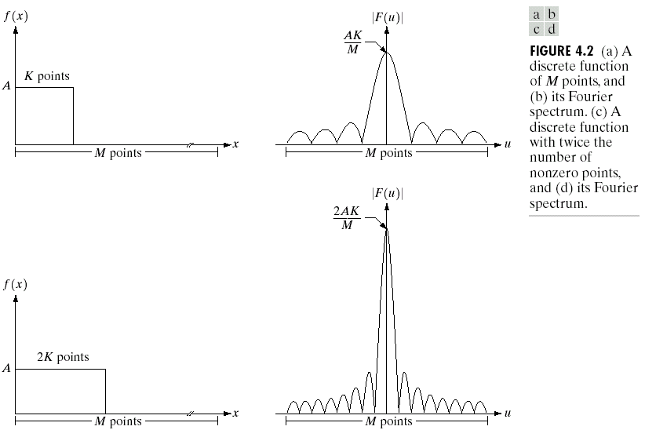
Some One-Dimensional Fourier Transform Examples
Please note the relationship between the value of K and the height of the spectrum and the number of zeros in the frequency domain.

Slide 13
Two Dimensional Fourier Transform & Its Inverse (Continuous Case)
The Fourier Transform, F(u , v) of a two variable continuous function f(x , y), is defined by the following equation:
Conversely, Given F(u , v), we can obtain f(x , y) by means of the Inverse Fourier Transform given by the following equation:
The above two equations comprise the Fourier Transform Pair in two dimension.

Slide 14
Sampling in 2 Dimension
Multiplying a continuous function f(t , z) by an impulse train s_{ΔTΔZ}(t , z) yields the 2D sampled function.
Similar mathematical formulation may be done for 2 Dimensional case, exactly in the same way as we did in case of 1 dimension.
The function f(t , z) is said to be band-limited if its Fourier Transform is 0 outside a rectangle established by the intervals [-μ_{max} , μ_{max}] and [-ν_{max} , ν_{max}].
Mathematically:

Slide 15
Sampling Theorem in 2 Dimension
The two dimensional sampling theorem states that a continuous, band-limited function f(t , z) can be reconstructed with no error from a set of its samples if the sampling intervals satisfy the following:
The same can be expressed in terms of sampling rate as follows:

Slide 16
The Two Dimensional DFT Pair
The discrete Fourier Transform of a function f(x , y) of size M X N is given by the following equation:
similarly, given F(u , v), we obtain f(x , y) via the inverse Fourier Transform, given by the equation:
The variables u & v are frequency variables and x & y are spatial or image variables.

Slide 17
Some Definitions
We define the Fourier spectrum, phase angle, and power spectrum of the two-dimensional Fourier transform as follows:
R(u , v): The real part of F(u , v).
I(u , v): The imaginary part of F(u , v).

Slide 18
Relationship Between Spatial & Frequency Intervals
Suppose that a continuous function f(t , z) is sampled to form a digital image, f(x , y), consisting of M X N samples taken in the t- and z- directions, respectively.
Let ΔT and ΔZ denote the separations between the samples.
Then the separations between the corresponding discrete, frequency domain variables are given by:

Slide 19
Translation of DFT
We can easily show the following:
We can interpret the above as follows:
Multiplying f(x , y) by exponential shown above shifts the origin of DFT to (u₀ , v₀).
Conversely, multiplying F(u , v) by negative of the same shifts the origin of f(x , y) to (x₀ , y₀).

Slide 20
Rotation of DFT
Using the polar coordinates:
results in the following transform pair:
The above indicates that rotating f(x , y) by an angle θ₀ rotates F(u , v) by the same angle.
Conversely, rotating F(u , v) rotates f(x , y) by the same angle.

Slide 21
Periodicity of DFT Pair
Fourier Transform and its inverse are infinitely periodic in u and v directions.
where k₁ and k₂ are integers.

Slide 22
Shifting Property of 2D DFT
It is a common practice to multiply an input image function by (-1)^{x + y} prior to computation of DFT. In that case:
In other words, the above operation shifts the origin of F(u , v) at (M/2 , N/2), which is the center of the M X N area occupied by the 2D DFT.
The above mentioned M X N area of the frequency domain is referred to as Frequency Rectangle. This extends from u = 0 to u = M – 1 and v = 0 to v = N – 1.

Slide 23
Average Property of 2D DFT Pair
The value of the 2D DFT at (u , v) = (0 , 0) is:
The above is nothing but the average of f(x , y).
In other words, if f(x , y) is an image, the value of 2D DFT at (0 , 0) is equal to the average gray level of the image.
The above average value is also called the dc component.

Slide 24
Symmetry of 2D DFT Pair
If f(x , y) is real, the 2D DFT of f(x , y) is Conjugate Symmetric in the following sense:
The above result also imply the following symmetric property of its magnitude, as follows:
Again as in 1D DFT, we have:

Slide 25
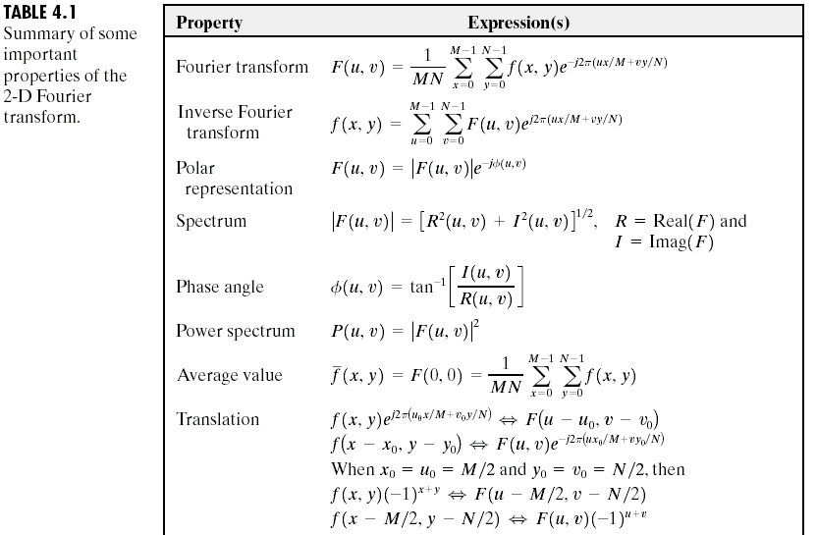
Some Important Properties of the 2-D Fourier Transform

Slide 26
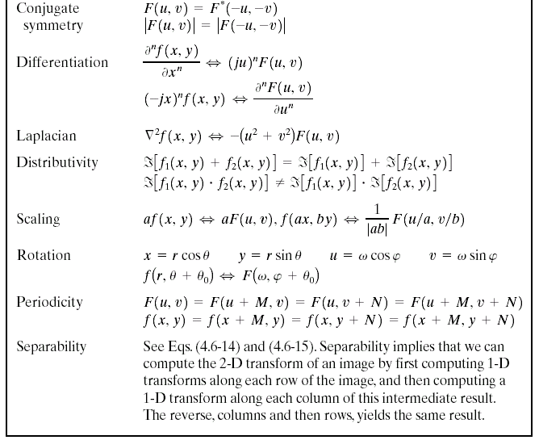

Some Important Properties of the 2-D Fourier Transform

Slide 27
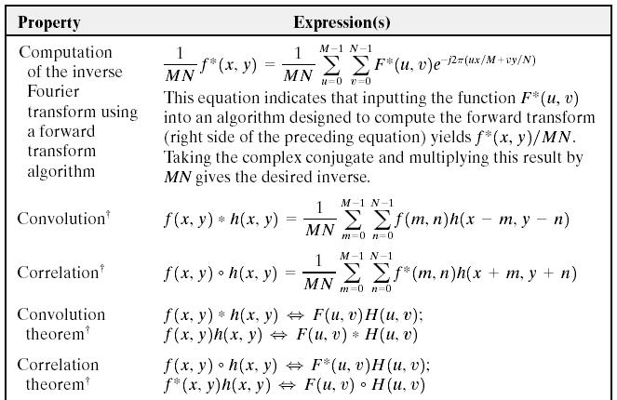
Some Important Properties of the 2-D Fourier Transform

Slide 28
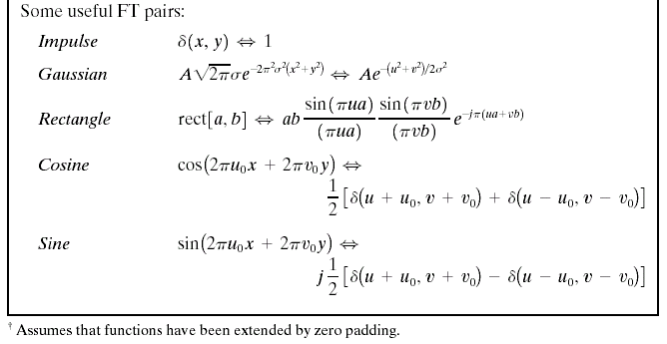
Some Important Properties of the 2-D Fourier Transform

Slide 29
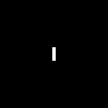
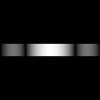
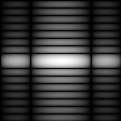
Some Examples of Two-dimensional DFT
The 2D DFT F(u , v) can be obtained by:
taking the 1D DFT of every row of image f(x , y) yielding F(u , y).
taking the 1D DFT of every column of F(u , y).
(a) f(x,y) (b) F(u,y) (c) F(u,v)
Convention of coordination:
y or v
x or u

Slide 30
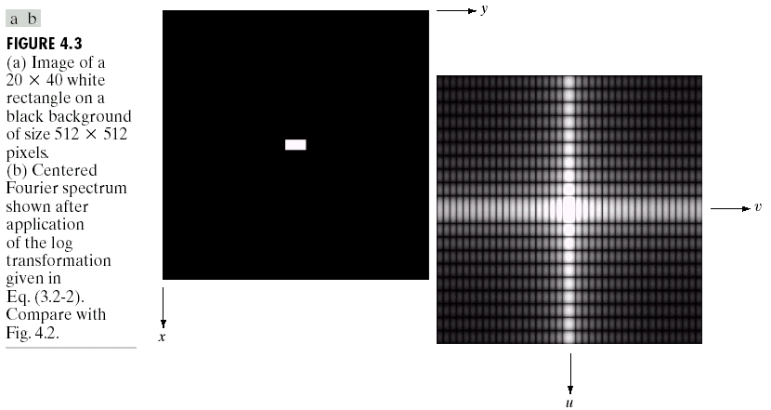
Some Examples of Two-dimensional DFT
shift
Consider the relationship between the separation of zeros in u- or v- direction and the width or height of white block of source image.

Slide 31
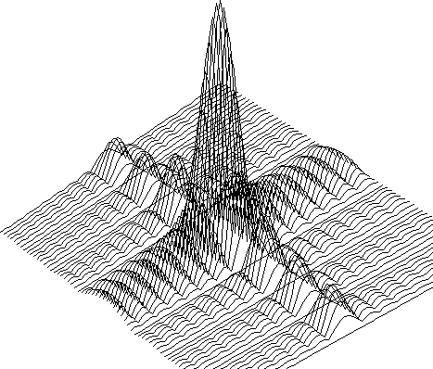
Shape of The Three-Dimensional Spectrum
Shape of three dimensional spectrum

Slide 32

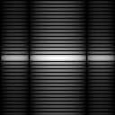
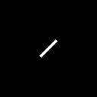
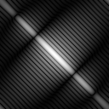
The Property of Two-Dimensional DFT Rotation
DFT
DFT

Slide 33

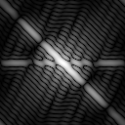
The Property of Two-Dimensional DFT Linear Combination
A
DFT
B
DFT
0.25 * A + 0.75 * B
DFT

Slide 34
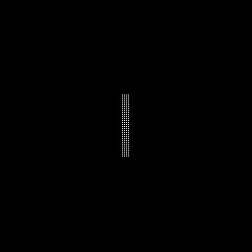
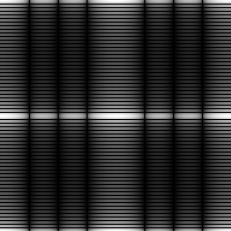
The Property of Two-Dimensional DFT Expansion
A
DFT
B
DFT
Expanding the original image by a factor of n (n=2), filling the empty new values with zeros, results in the same DFT.

Slide 35
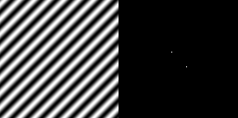
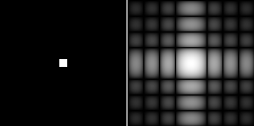
Two-Dimensional DFT with Different Functions
Sine wave
Its DFT
Rectangle
Its DFT

Slide 36

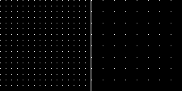
Two-Dimensional DFT with Different Functions
2D Gaussian
function
Its DFT
Impulses
Its DFT

Slide 37
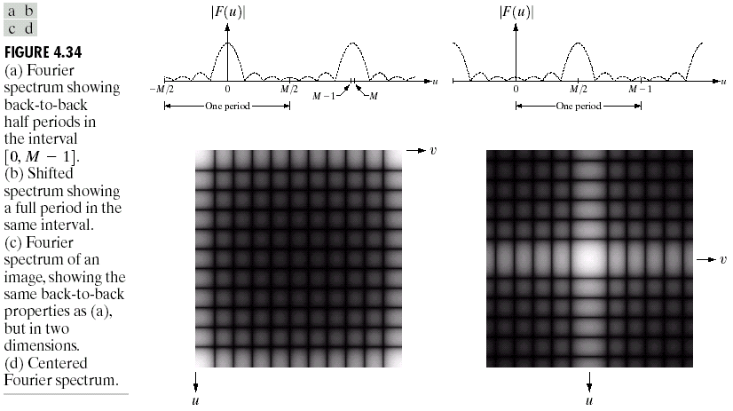
Two-Dimensional DFT with Different Functions

Slide 38
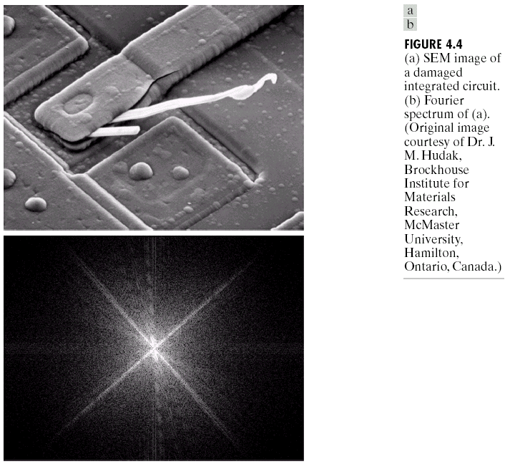
Two-Dimensional DFT of An Image
Frequency is directly related to rate of change. The frequency of fast varying components in an image is higher than slowly varying components.

Slide 39


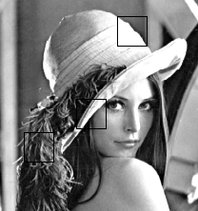




Two-Dimensional DFT of An Image
a
a
b
b
c
c
Image
Fourier
transform

Slide 40
Filtering in Frequency Domain: Observations
The slowest varying frequency component (u = v = 0) corresponds to average gray level of an image.
As we move away from the origin of the transformation, the low frequencies correspond to the slowly varying components of an image.
In other words, they corresponds to regions of smooth gray level variations in the image.

Slide 41
Filtering in Frequency Domain: Observations
As we move further away from the origin, the higher frequencies begin to correspond to faster and faster intensity changes in the image.
In other words, higher frequency components corresponds to edges and abrupt changes given by noise.

Slide 42
Filtering in the Frequency Domain
Frequency is directly related to rate of change. The frequency of fast varying components in an image is higher than slowly varying components.

Slide 43
Filtering in Frequency Domain: Basics
Multiply the input image by (-1)^{x +} ^{y} to center the transform.
Compute F(u , v), the 2D DFT of the image f(x , y).
Multiply F(u , v) by filter function H(u , v).
Compute inverse DFT of the result in (3).
Obtain the real part of the result in (4).
Multiply the result in (5) by (-1)^{x +} ^{y} .

Slide 44
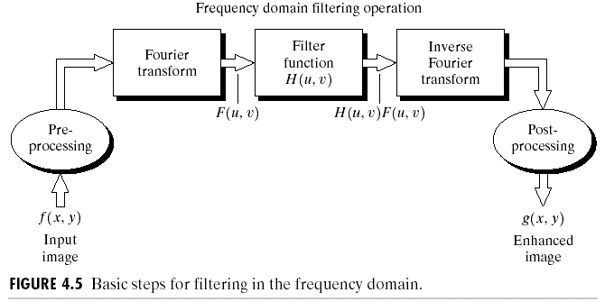
Filtering in the Frequency Domain: Basics
Including multiplication the input/output image by (-1)^{x + y}.
What is zero-phase-shift filter?

Slide 45
Filters in Frequency Domain
The reason that H(u , v) is called a filter is because it suppresses certain frequencies in the transform while leaving the others unchanged.
Let f(x , y) denote the input image in step (1) and F(u , v) its DFT. Then in step (3), we get,
In our case, we assume that filters are all real filters.
Such filters are called zero-phase-shift filters, since application of these does not change the phase φ(u , v) of the transform.

Slide 46
Filters in Frequency Domain
The filtered image is obtained by taking the inverse DFT of G(u , v).
In general, inverse DFT is a complex quantity. But if the input image and the filter function are both real, the imaginary component of the inverse transform should ideally all be zero.
In practice, the inverse DFT has parasitic imaginary components due to computational round off errors. These components must be ignored.

Slide 47
Some Basic Filters and Their Functions
Suppose we wish to force the average value of an image to zero.
We know that the average value of an image is given by F(0 , 0), or by F(M/2 , N/2), if the image transform has been centered.
Hence the corresponding filter function would be given by the filter in the following slide.

Slide 48
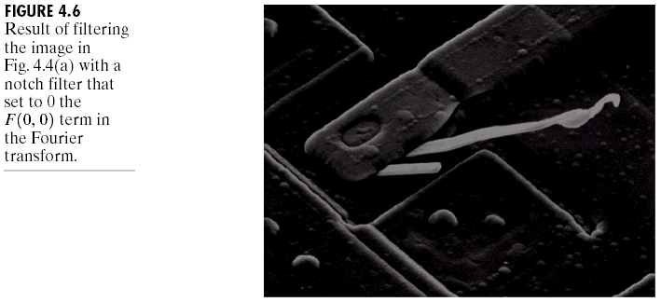
Some Basic Filters and Their Functions
Multiply all values of F(u , v) by the filter function (Notch filter):
All this filter would do is set F(0,0) to zero (force the average value of an image to zero) and leave all other frequency components of the Fourier transform untouched and make prominent edges stand out.

Slide 49
Some Basic Filters and Their Functions
Low frequencies in the Fourier Transform are responsible for the general gray level appearance of an image over smooth areas, while high frequencies are responsible for detail, such as edges and noise.
A filter that attenuates high frequencies while passing low frequencies is called a Low-pass Filter.
We would expect that a low-pass filtered image to have less sharp detail than the original image.
A filter that has the opposite characteristic is called a High-pass Filter.
On the other hand, a high-pass filtered image have less gray level variations in smooth areas and emphasized transitional (edge) gray level detail.

Slide 50
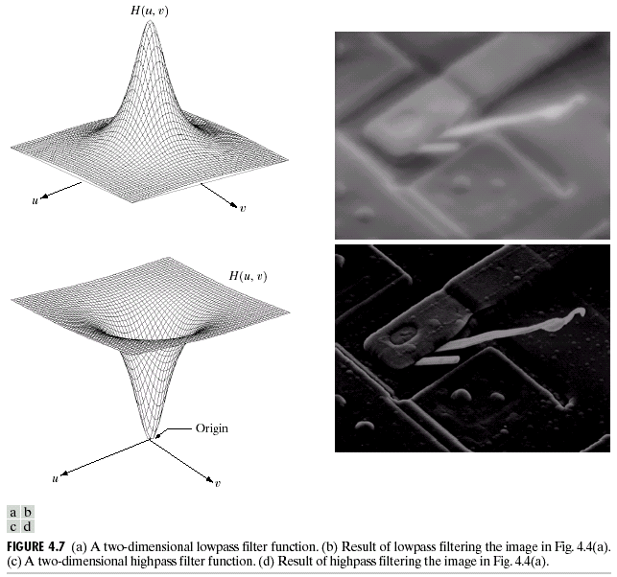
Some Basic Filters and Their Functions
Low-pass filter
Circular symmetry
High-pass filter

Slide 51
The Convolution Operation
The most fundamental relationship between the spatial and frequency domain is established by a well-known result, called the Convolution Theorem.
Convolution is the process by which we move a mask from pixel to pixel in an image, and compute a predefined quantity at each pixel.
In the next few slides, we demonstrate convolution theorem.

Slide 52
Convolution Operation in 2 Dimension
The discrete convolution of two functions f(x , y) and h(x , y) of size M × N is defined as
The process of implementation:
Flipping one function about the origin;
Shifting that function with respect to the other by changing the values of (x , y);
Computing a sum of products over all values of m and n, for each displacement.

Slide 53
The Convolution Theorem
Let F(u , v) and H(u , v) denote the Fourier Transforms of f(x , y) and h(x , y), respectively.
One part of the convolution theorem states that f(x , y) * h(x , y) and F(u , v) H(u , v) constitute a Fourier Transform pair. Formally,
The other part of the theorem states that convolution in the frequency domain reduces to multiplication in the spatial domain, and vice versa. Formally,

Slide 54
Fourier Transform of A Unit Impulse
Letting f or h be an impulse function in the equation for f(x , y) * h(x , y), we would conclude after a little manipulation that convolution of a function with an impulse copies the value of that function at the location of the impulse.
The Fourier Transform of a unit impulse at the origin is:

Slide 55
Spatial Domain Filter vs. Frequency Domain Filter
We note that,
Combining above facts, we get,
Hence, we have established that filters in the spatial domain and in the frequency domain constitutes a Fourier Transform pair.

Slide 56
Spatial Domain Filter vs. Frequency Domain Filter
Thus, given a filter in the frequency domain, we can obtain the corresponding filter in the spatial domain by taking the inverse Fourier Transform of the former.
Similarly, given a filter in the spatial domain, we can obtain the corresponding filter in the frequency domain by taking the Fourier Transform of the former.

Slide 57
Spatial Domain Filter vs. Frequency Domain Filter: 1 Dimension
Let H(u) in the following equation denotes a frequency domain Gaussian Filter function.
It can be shown that the corresponding filter in the spatial domain is the following.
Both the components are real and Gaussian.
The functions behave reciprocally with respect to each other. When H(u) has large value of σ (i.e., a high profile), then h(x) has a narrow value of the same (i.e., a narrow profile).

Slide 58
Spatial Domain Filter vs. Frequency Domain Filter: 1 Dimension
Graph of H(u) resembles a low-pass filter, as shown in the diagram next.
We can construct a high-pass filter as the difference of Gaussian functions as follows.
The corresponding filter in the spatial domain is the following.

Slide 59
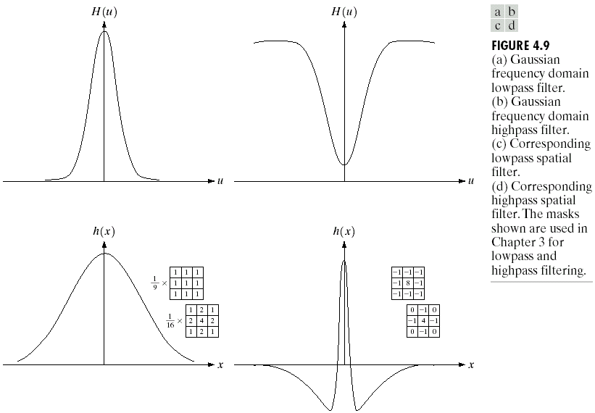

Slide 60
Some important properties of Gaussian filters functions
One very useful property of the Gaussian function is that both it and its Fourier transform are real valued; there are no complex values associated with them.
In addition, the values are always positive. So, if we convolve an image with a Gaussian function, there will never be any negative output values to deal with.
There is also an important relationship between the widths of a Gaussian function and its Fourier transform. If we make the width of the function smaller, the width of the Fourier transform gets larger. This is controlled by the variance parameter σ² in the equations.
These properties make the Gaussian filter very useful for low-pass filtering an image. The amount of blur is controlled by σ². It can be implemented in either the spatial or frequency domain.
Other filters besides low-pass can also be implemented by using two different sized Gaussian functions.

Slide 61
Smoothing Frequency-Domain Filters
The basic model for filtering in the frequency domain is given by the following equation:
where F(u , v) is the Fourier transform of the image to be smoothed and H(u ,v) is a filter transfer function to be selected.
Smoothing is fundamentally a low-pass operation in the frequency domain.
So, the objective is to select a filter transfer function H(u , v) that yields G(u , v) by attenuating the high frequency components of F(u , v).
There are several standard forms of low-pass filters (LPF).
Ideal low-pass filter (ILPF).
Butterworth low-pass filter (BLPF).
Gaussian low-pass filter (GLPF).

Slide 62
Ideal Low-pass Filters (ILPFs)
The simplest low-pass filter is a filter that “cuts off” all high-frequency components of the Fourier transform that are at a distance greater than a specified distance D₀ from the origin of the transform.
The transfer function of an ideal low-pass filter is the following.
where D(u , v) : the distance from point (u , v) to the center of their frequency rectangle (M/2 , N/2).

Slide 63
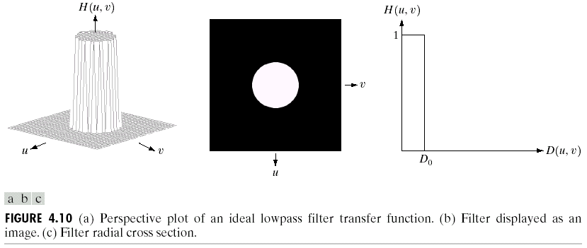
Ideal Low-pass Filters (ILPFs)
cutoff frequency
ILPF is a type of “nonphysical” filters and can’t be realized with electronic components and is not very practical.

Slide 64
Ideal Low-pass Filters (ILPFs)
The value of D₀ is called the “cut-off frequency”.
One way to establish a standard cut-off frequencies is to compute circles that enclosed specified amounts of total image power P_{T} given by:
If the transformation has been centered, a circle of radius r with origin at the center of the frequency rectangle enclosed α percent of the power, where,
where the summation is taken over the values of (u , v) that lie inside the circle or on its boundary.

Slide 65
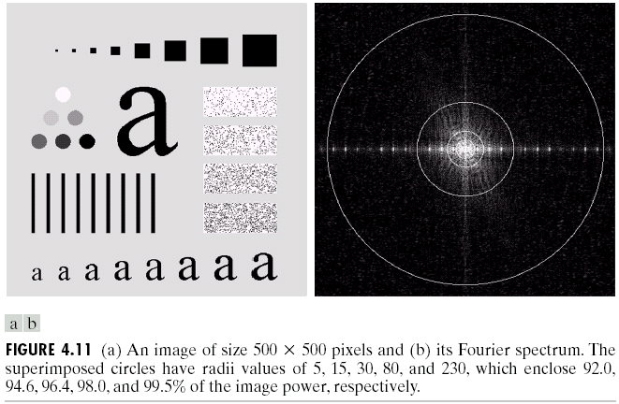
An Image & Its Fourier Spectrum

Slide 66
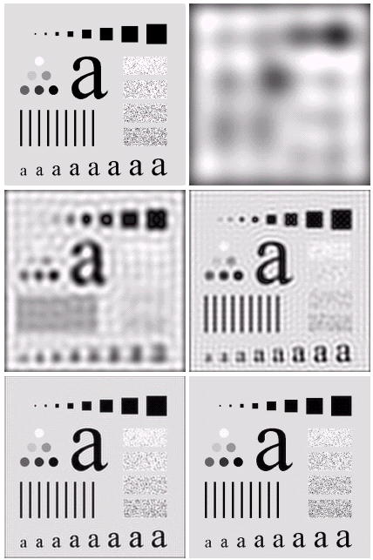

Application of ILPF to Previous Image
The blurring and ringing phenomena can be seen, in which ringing behavior is characteristic of ideal filters.

Slide 67
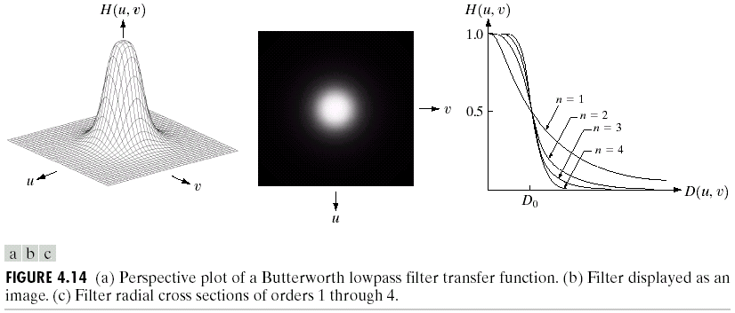
Butterworth Low-pass Filter (BLPF) with order n
Note the relationship between order n and smoothing.
The BLPF may be viewed as a transition between ILPF AND GLPF, BLPF of order 2 is a good compromise between effective low-pass filtering and acceptable ringing characteristics.

Slide 68
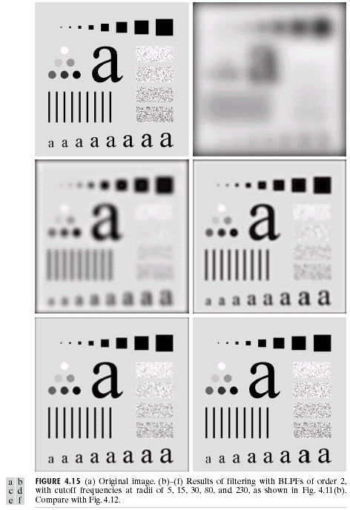
Butterworth Low-pass
Filter (BLPF)
n=2
D₀=5,15,30,80,and 230

Slide 69
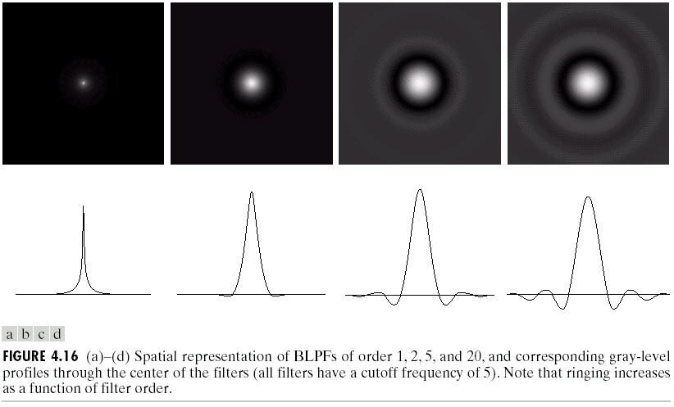
Butterworth Low-pass Filters (BLPFs)
Spatial Representation
n=1
n=2
n=5
n=20

Slide 70
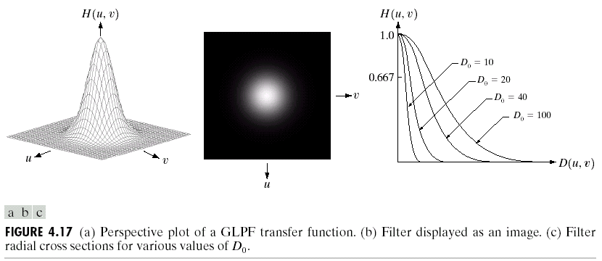
Gaussian Low-pass Filter (GLPF)

Slide 71
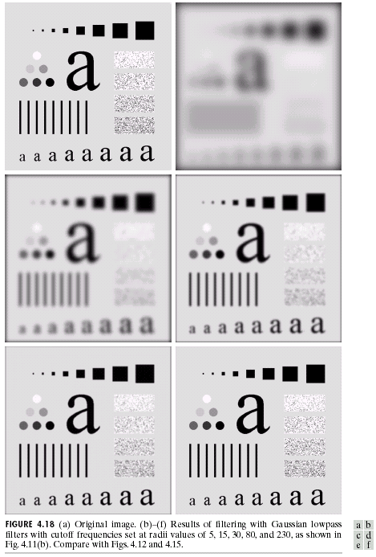
Gaussian Low-pass
Filter (GLPF)
D₀=5,15,30,80,and 230

Slide 72
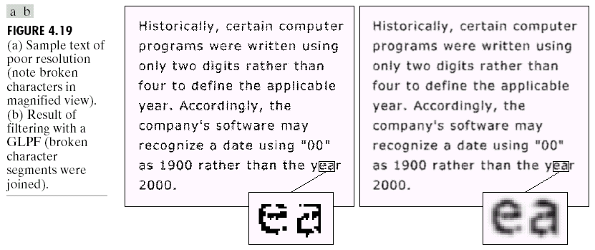
Additional Examples of Low-pass Filtering
Character recognition in machine perception: join the broken character segments with a Gaussian low-pass filter with D₀=80.

Slide 73
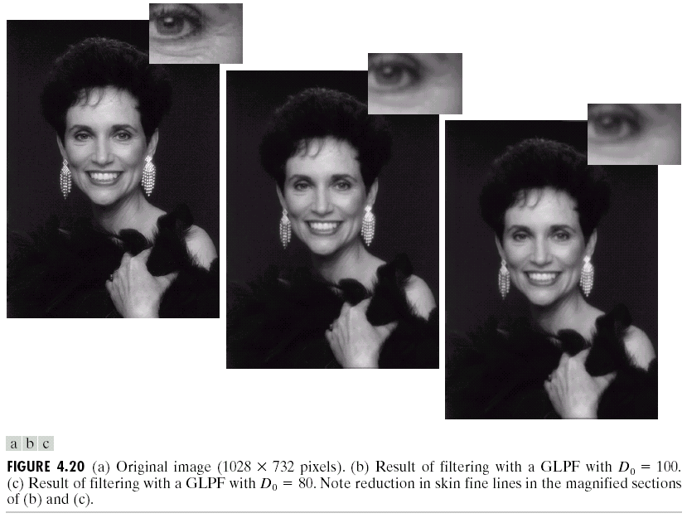
Additional Examples of Low-pass Filtering
Application in “cosmetic processing” and produce a smoother, softer-looking result from a sharp original.

Slide 74
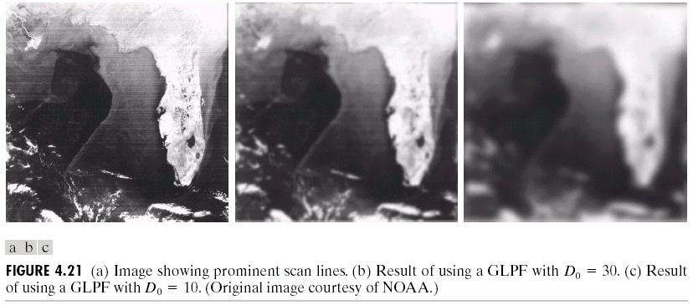
Additional Examples of Low-pass Filtering
Gaussian low-pass filter for reducing the horizontal sensor scan lines and simplifying the detection of features like the interface boundaries.

Slide 75
Sharpening Frequency Domain Filter
Edges and other abrupt changes in gray levels are associated with high frequency components.
So, image sharpening can be achieved in the frequency domain by a high-pass filtering process.
High-pass filtering process attenuates the low frequency components without disturbing high frequency information in the Fourier transform.
Thus, intended function of the filters in this section is to perform precisely the reverse operation of the low-pass filters in the previous section.
Hence transfer function of the high-pass filters discussed in this section can be obtained using the following relation:

Slide 76
Sharpening Frequency Domain Filter
The previous relation suggests that when low-pass filter attenuates frequencies, the high-pass filter passes them; and vice versa.
Following are the categories of high-pass filters:
Ideal High-pass Filter (IHPF).
Butterworth High-pass Filter (BHPF).
Gaussian High-pass Filter (GHPF).
As before, we shall see that the Butterworth filter represents a transition between the sharpness of the ideal filter and the total smoothness of the Gaussian Filter.

Slide 77
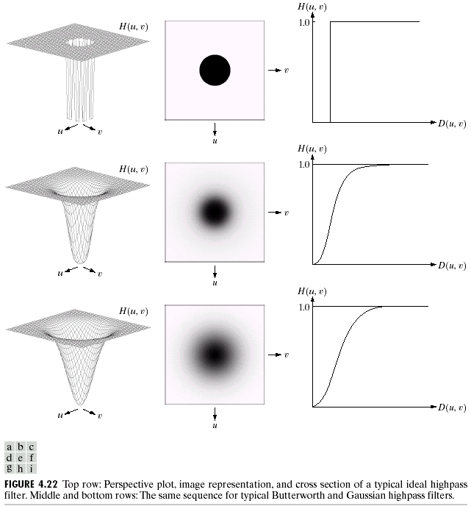
Sharpening Frequency Domain Filter
Ideal highpass filter
Butterworth highpass filter
Gaussian highpass filter

Slide 78
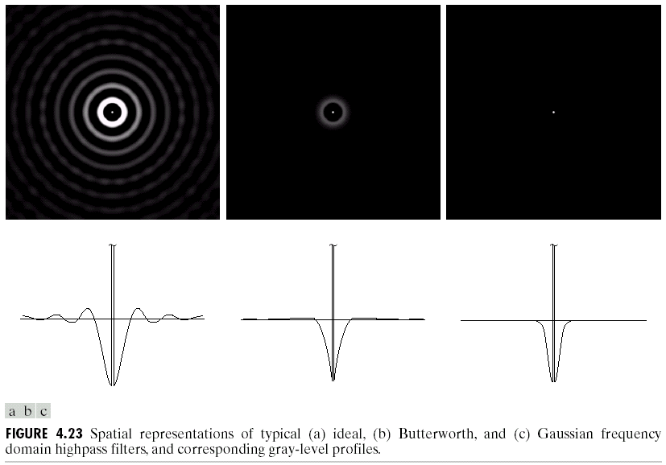
High-pass Filters: Spatial Representations

Slide 79
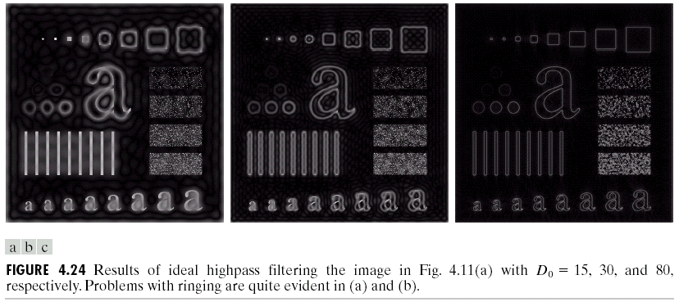
Ideal High-pass Filters (IHPF)
non-physically realizable with electronic component and have the same ringing properties as ILPFs.

Slide 80
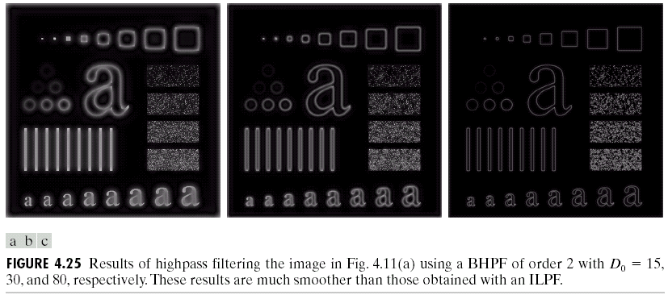
Butterworth High-pass Filters
The result is smoother than that of IHPFs and sharper than that of GHPFs

Slide 81
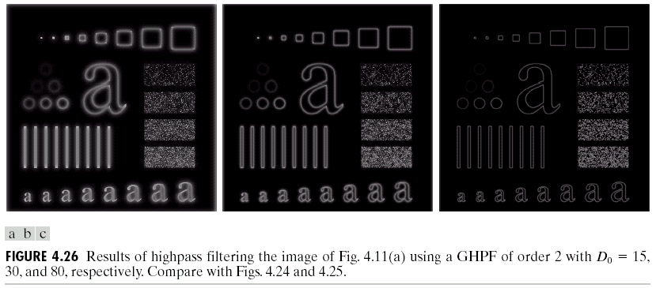
Gaussian High-pass Filters
The result is the smoothest in three types of high-pass filters

Slide 82
The Laplacian in the Frequency Domain
The Fourier Transform of n-order differential of a function f(x) is
For a two-dimensional function f(x , y), it can be shown that
So, Laplacian can be implemented in the frequency domain by using the filter
Shift the center to (M/2 , N/2) and obtain
We have the following Fourier transform pairs

Slide 83
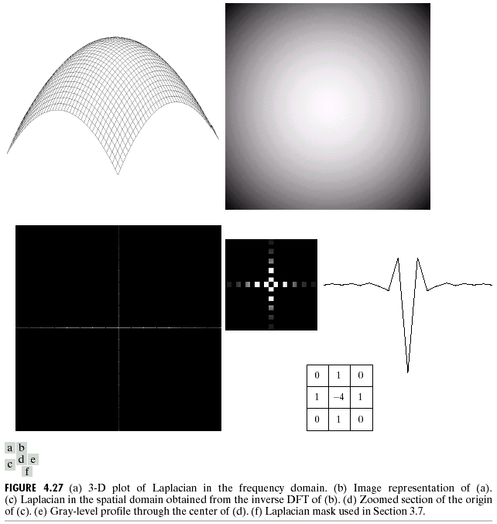
The plot of Laplacian in frequency and spatial domain
Frequency
domain
Spatial domain

Slide 84
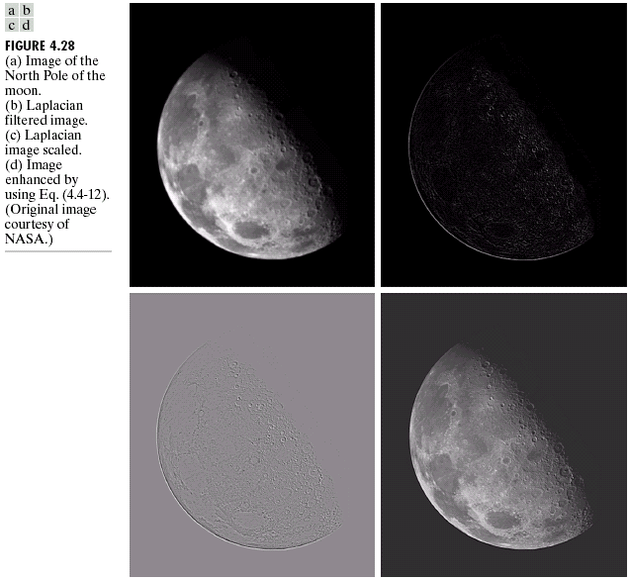
A integrated operation in frequency domain
For display purposes only

Slide 85
Un-sharp Masking
Un-sharp masking consists simply of generating a sharp image by subtracting from an image a blurred version of itself.
The above means that obtaining a high-pass filtered image by subtracting from an image a low-pass filtered version of itself.
That is to say,

Slide 86
Un-sharp Masking
Now, by taking Fourier Transform on either side, we get,
But,
where H_{lp} is the transfer function of the low-pass filter.
Therefore, un-sharp masking can be implemented directly in the frequency domain using the composite filter:

Slide 87
High-Boost Filtering
High-boost filtering is a generalized version of un-sharp masking, which may be formally written as follows:
The above may be rewritten as follows:
When A = 1, High-Boost filtering reduces to regular high-pass filtering.
High-boost filtering can be implemented in the frequency domain with the composite filter:

Slide 88
High Frequency Emphasis Filtering
Sometimes it is advantageous to accentuate the contribution to enhancement made by the high frequency components of an image.
In that case, we simply multiply a high-pass filter function by a constant and add an offset so that the zero frequency term is not eliminated by the filter. This process is called High-Frequency Emphasis.
The above procedure has a filter function as follows:
Typical values of a & b are: 0.25 ≤ a ≤ 0.5, 1.5 ≤ b ≤ 2.0.

Slide 89
Homomorphic Filtering
A simple image model: illumination–reflection model.
f(x , y) : the intensity. Also called the gray level for monochrome image.
f(x , y) = i(x , y)*r(x , y), where
0 ≤ i(x , y) ≤ Inf, the illumination.
0 ≤ r(x , y) ≤ 1, the reflectance.

Slide 90
Homomorphic Filtering
The illumination component
Slow spatial variations
Low frequency
The reflectance component
Vary abruptly, particularly at the junctions of dissimilar objects
High frequency
Homomorphic filters
Effect low and high frequency differently
Compress the low frequency dynamic range
(brightness compression)
Enhance the contrast in high frequency
Notes:
The illumination component of an image generally is characterized by slow spatial variations, while the reflectance component tends to vary abruptly, particularly at the junctions of dissimilar objects.
The net results of homomophic filtering is simultaneous dynamic range compression and contrast enhancement.

Slide 91
Homomorphic Filtering
Suppose we define,
Then taking Fourier Transform,

Slide 92
Homomorphic Filtering
Suppose, we can filter Z(u , v) using a filter function H(u , v). So we get,
Taking inverse Fourier Transform,

Slide 93
Homomorphic Filtering
If g(x , y) denote the filtered image, then
Here i₀(x , y) and r₀(x , y) are the illumination and reflectance components of the processed image.

Slide 94
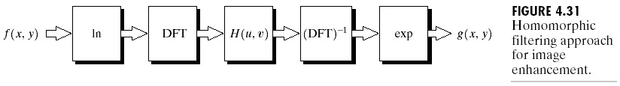
Homomorphic Filtering

Slide 95
Homomorphic Filtering
In homomorphic filtering, the filter function H(u , v) affects high and low frequency components of DFT in different, controllable ways.
In the next diagram, we have such a filter function in 2 dimension.
If the parameters γ_{L} and γ_{H} are chosen so that γ_{L} < 1 and γ_{H} > 1, the above filter function tends to
Attenuate the contribution made by low frequencies (illumination), and
Amplify the contribution made by high frequencies (reflectance).

Slide 96
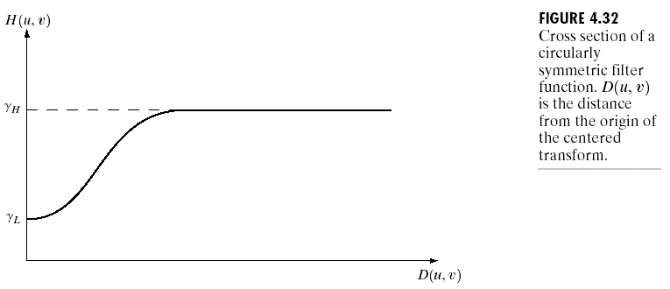
Homomorphic Filtering
Notes:
The paramenters gamma_L and gamma_H are chosen so that gamma_L<1 and gamma_H>1. The curve shape can be approximated using the basic form of any of the ideal highpass filters.

Slide 97
Homomorphic Filtering
A typical filter function having above mentioned nature is the following:
The constant c controls the sharpness of the slope of the function as it transitions from γ_{L} to γ_{H}.

Slide 98
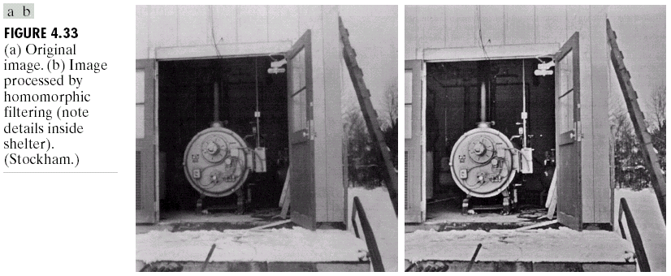
Homomorphic Filtering
Notes:
Gamma_L = 0.5, Gamma_H =2.0. A reduction of dynamic range in the brightness, together with an increase in contrast, brought out the details of objects inside the shelter and balanced the gray levels of the outside wall. The enhanced image is also sharper.

Slide 99
Selective Filters
There are applications in which it is of interest to process a specific band of frequencies or small regions of the frequency rectangle.
The filters in the first category are called band-reject or band-pass filters.
The filters in the second category are called notch-reject or notch-pass filters.

Slide 100
Band-Reject & Band-Pass Filters
Ideal Band-reject Filter:
Butterworth Band-reject Filter of order n:

Slide 101
Band-Reject & Band-Pass Filters
Gaussian Band-reject Filter:
In all the above cases, W denote the width of the Band.
A band-pass filter is obtained from the band-reject filter using the following expression:

Slide 102
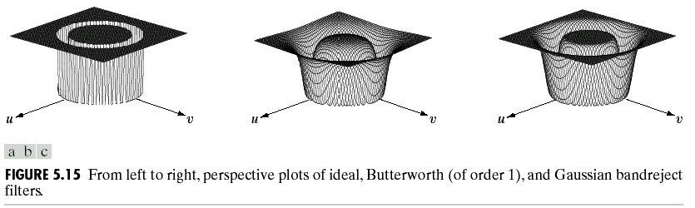
Band Reject Filters

Slide 103
Notch-Reject & Notch-Pass Filters
A notch filter rejects (or passes) frequencies in a predefined neighborhood about the center of the frequency rectangle.
We know that a zero-phase-shift filters are those filters that affect the real and imaginary parts of the Fourier Transform equally.
Thus, these filters have no change on the phase of the transform.
These filters must be symmetric about origin.

Slide 104
Notch-Reject & Notch-Pass Filters
Since, we are dealing only with zero-phase-shift filters, the notch filters in our case will also be so.
So in our filters, a notch with center at (u₀ , v₀) must have a corresponding notch at (-u₀ , -v₀).
Notch-reject filters are constructed as products of high-pass filters whose centers have been translated to the centers of the notches.
A notch-pass filter is obtained from a notch-pass using the expression:

Slide 105
Notch-Reject & Notch-Pass Filters
A notch-reject filter can be expressed as:
where H_{k}(u , v) and H_{-k}(u , v) are high-pass filters whose centers are at (u_{k} , v_{k}) and (-u_{k} , -v_{k}), respectively.
Centers of all the high-pass filters used are specified with respect to (M/2 , N/2), the center of the frequency rectangle.

Slide 106
Notch-Reject & Notch-Pass Filters
The distance computation for each high-pass filter is carried out as:
Example. A Butterworth notch-reject filter of order n, containing three notches is as follows:

Slide 107
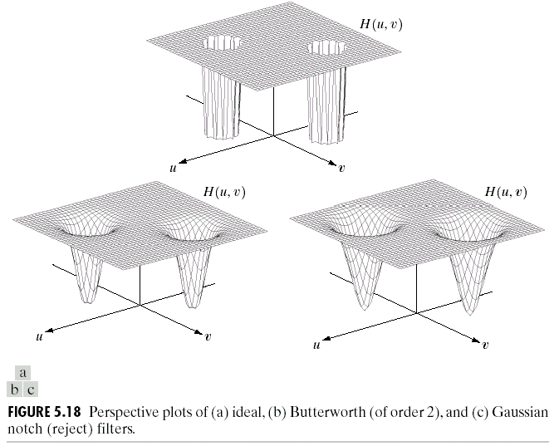
Notch Reject Filters

